Slide 1


API Testing with Rest Assured
January 2019
1
Notes:
‹#›

Slide 2
Agenda
API Testing
The Application for Test
POSTMAN API Testing
Rest Assured Introduction and Setup
Basic Requests
Logging Mechanism
Extracting Data
Using Assertions
Authentication
2
Notes:
‹#›
Slide Number

Slide 3


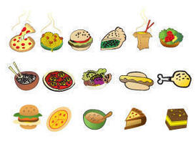
API Testing
Wikipedia Definition:
In computer programming, an application programming interface (API) is a set of subroutine definitions, communication protocols, and tools for building software. In general terms, it is a set of clearly defined methods of communication among various components.
Consumer
API
Provider
Request
Request
Response
Response
Customer
Waiter
Kitchen
2

Slide 4
API Basics
http://www.studentportal.com/student/2?firstName
http:// : protocol
www.studentportal.com/ : domain
student/ : path
2 : path parameter
?firstName : query parameter
HTTP Verbs
GET - retrieves a record
POST - adds a record
PUT - replaces a record
PATCH - modifies an existing record
DELETE - removes a record
2

Slide 5
API Basics
http://www.studentportal.com/student/2?firstName
http:// : protocol
www.studentportal.com/ : domain
student/ : path
2 : path parameter
?firstName : query parameter
HTTP Verbs
GET - retrieves a record
POST - adds a record
PUT - replaces a record
PATCH - modifies an existing record
DELETE - removes a record
2

Slide 6
The Application for Test
Student App Demo
This app provides list of students and their details based on the request.
2

Slide 7
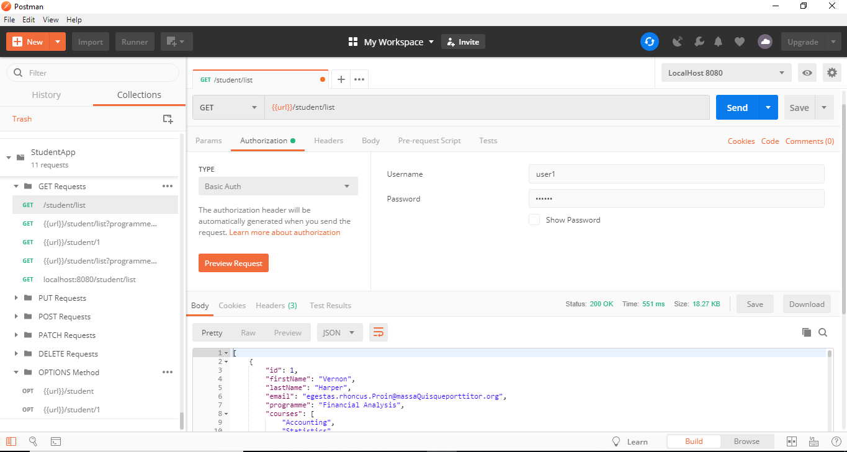
POSTMAN
https://www.getpostman.com/
2
Notes:
‹#›

Slide 8
Rest Assured Introduction and Setup
MVN Dependency
<dependency> <groupId>io.rest-assured</groupId> <artifactId>rest-assured</artifactId> <version>3.0.2</version> </dependency>
2
Notes:
‹#›
Slide Number

Slide 9
Basic Requests
Response response= given() .param("programme", "Financial Analysis") .param("limit",2) .when() .get("/list");
given() .when() .delete("/12") .then() .statusCode(204);
2
Notes:
‹#›
Slide Number

Slide 10
Logging Mechanism
given() .log() .headers() .when() .get("/1") .then() .statusCode(400);
given() .param("programme", "Computer Science") .param("limit",1) .when() .get("/list") .then() .log() .status() .statusCode(200);
2
Notes:
‹#›
Slide Number

Slide 11
Extracting Data
given() .queryParam("query","ipod") .queryParam("format","json") .when() .get("/search") .then() .log().all().extract().path("numItems");
given() .queryParam("query", "ipod") .queryParam("apiKey", APIKEY) .queryParam("format", "xml") .when() .get("/search") .then() .extract() .path("searchresponse.numItems");
2
Notes:
‹#›
Slide Number

Slide 12
Using Assertions
given() .parameters(parameters) .when() .get("/yql") .then() .body("query.count", equalTo(6));
2
Notes:
‹#›
Slide Number

Slide 13
Authentication
a
2
Notes:
‹#›
Slide Number

Slide 14
Thank You
7
Notes:
‹#›
Slide Number

